Slide 1
Expert Systems
Inference Strategies

Slide 2
Expert System
An expert system is a system that utilizes human knowledge captured in a computer to solve problems that ordinarily require human expertise.
It is a computer program designed not just to process data, but to mimic the reasoning and problem-solving skills of one or more human experts in a specific, narrow field (e.g., medical diagnosis, financial planning, equipment repair).
It solves complex problems by using reasoning methods applied to a body of formalized knowledge, rather than using traditional procedural programming.
A computer program that emulates the behaviour of human experts who are solving real-world problems associated with a particular domain of knowledge.

Slide 3
Expert System
Computer software that:
  Emulates human expert.
  Deals with small, well defined domains of expertise.
  Is able to solve real-world problems.
  Is able to act as a cost-effective consultant.
  Can explains reasoning behind any solutions it finds.
  Should be able to learn from experience.

Slide 4
Production system model

Slide 5
Basic structure of a rule-based expert system

Slide 6
Inference Engine
Inference engine is the "brain" of the expert system.
It is a set of procedures that uses the information (Facts) from the Database and the rules (IF-THEN) from the Knowledge Base to perform the reasoning.
It applies the rules to the facts to draw conclusions and arrive at a solution.
The two primary methods used by the Inference Engine are Forward Chaining (data-driven reasoning) and Backward Chaining (goal-driven reasoning).
These two approaches are dictated by whether the inference engine is being driven by the antecedent (left hand side) or the consequent (right hand side) of the rule.
  Forward Chaining
  Backward Chaining

Slide 7
Forward Chaining
Forward Chaining is a reasoning method used by the Inference Engine in knowledge-based systems, such as Expert Systems and Production Systems.
The reasoning starts with a set of known facts, derives new facts using rules whose premises match the known facts, and continues this process until a goal state is reached or until no further rules have premises that match the known or derived facts.
How does a doctor go about diagnosing a patient.
  Asks for symptoms.
  Infers diagnosis from symptoms.

Slide 8
Forward Chaining Approach
The process begins with a set of initial facts loaded into the Working Memory (Short-Term Memory).
The Inference Engine scans the entire Knowledge Base (Long-Term Memory) to find every Production Rule whose condition (IF-part) is satisfied (matched) by the facts currently in the Working Memory.
When matches found for all premises of a rule, place the conclusion of the rule in Working Memory.
Repeat this process until no more facts can be added or goal is reached.

Slide 9
Forward Chaining Example
Knowledge Base:
  If [X croaks and eats flies] Then [X is a frog]
  If [X chirps and sings] Then [X is a canary]
  If [X is a frog] Then [X is colored green]
  If [X is a canary] Then [X is colored yellow]
Database (Working Memory)
  [Fritz croaks and eats flies]
Goal:
  [Fritz is colored Y]?

Slide 10
Forward Chaining Example
Knowledge Base
If [X croaks and eats flies]
Then [X is a frog]
If [X chirps and sings]
Then [X is a canary]
If [X is a frog]
Then [X is colored green]
If [X is a canary]
Then [X is colored yellow]
Working Memory
[Fritz croaks and eats flies]
Goal
[Fritz is colored Y]?

Slide 11
Forward Chaining Example
Knowledge Base
If [X croaks and eats flies]
Then [X is a frog]
If [X chirps and sings]
Then [X is a canary]
If [X is a frog]
Then [X is colored green]
If [X is a canary]
Then [X is colored yellow]
[Fritz croaks and eats flies]
Goal
[Fritz is colored Y]?

Slide 12
Forward Chaining Example
If [X croaks and eats flies]
Then [X is a frog]
Knowledge Base
If [X croaks and eats flies]
Then [X is a frog]
If [X chirps and sings]
Then [X is a canary]
If [X is a frog]
Then [X is colored green]
If [X is a canary]
Then [X is colored yellow]
[Fritz croaks and eats flies]
Goal
[Fritz is colored Y]?
[Fritz croaks and eats flies]
[Fritz is a frog]

Slide 13
Forward Chaining Example
If [X croaks and eats flies]
Then [X is a frog]
Knowledge Base
If [X croaks and eats flies]
Then [X is a frog]
If [X chirps and sings]
Then [X is a canary]
If [X is a frog]
Then [X is colored green]
If [X is a canary]
Then [X is colored yellow]
[Fritz croaks and eats flies]
[Fritz is a frog]
Goal
[Fritz is colored Y]?
[Fritz croaks and eats flies]
[Fritz is a frog]

Slide 14
Forward Chaining Example
If [X croaks and eats flies]
Then [X is a frog]
Knowledge Base
If [X croaks and eats flies]
Then [X is a frog]
If [X chirps and sings]
Then [X is a canary]
If [X is a frog]
Then [X is colored green]
If [X is a canary]
Then [X is colored yellow]
[Fritz croaks and eats flies]
[Fritz is a frog]
Goal
[Fritz is colored Y]?
[Fritz croaks and eats flies]
[Fritz is a frog]
?

Slide 15
Forward Chaining Example
If [X croaks and eats flies]
Then [X is a frog]
Knowledge Base
If [X croaks and eats flies]
Then [X is a frog]
If [X chirps and sings]
Then [X is a canary]
If [X is a frog]
Then [X is colored green]
If [X is a canary]
Then [X is colored yellow]
[Fritz croaks and eats flies]
[Fritz is a frog]
Goal
[Fritz is colored Y]?
[Fritz croaks and eats flies]
[Fritz is a frog]

Slide 16
Forward Chaining Example
If [X croaks and eats flies]
Then [X is a frog]
Knowledge Base
If [X croaks and eats flies]
Then [X is a frog]
If [X chirps and sings]
Then [X is a canary]
If [X is a frog]
Then [X is colored green]
If [X is a canary]
Then [X is colored yellow]
[Fritz croaks and eats flies]
[Fritz is a frog]
Goal
[Fritz is colored Y]?
[Fritz croaks and eats flies]
If [X is a frog]
Then [X is colored green]
[Fritz is a frog]
[Fritz is colored green]

Slide 17
Forward Chaining Example
If [X croaks and eats flies]
Then [X is a frog]
Knowledge Base
If [X croaks and eats flies]
Then [X is a frog]
If [X chirps and sings]
Then [X is a canary]
If [X is a frog]
Then [X is colored green]
If [X is a canary]
Then [X is colored yellow]
[Fritz croaks and eats flies]
[Fritz is a frog]
[Fritz is colored green]
Goal
[Fritz is colored Y]?
[Fritz croaks and eats flies]
If [X is a frog]
Then [X is colored green]
[Fritz is a frog]
[Fritz is colored green]

Slide 18
Forward Chaining Example
If [X croaks and eats flies]
Then [X is a frog]
Knowledge Base
If [X croaks and eats flies]
Then [X is a frog]
If [X chirps and sings]
Then [X is a canary]
If [X is a frog]
Then [X is colored green]
If [X is a canary]
Then [X is colored yellow]
[Fritz croaks and eats flies]
[Fritz is a frog]
[Fritz is colored green]
Goal
[Fritz is colored Y]?
[Fritz croaks and eats flies]
If [X is a frog]
Then [X is colored green]
[Fritz is a frog]
[Fritz is colored green]
?

Slide 19
Forward Chaining Example
If [X croaks and eats flies]
Then [X is a frog]
Knowledge Base
If [X croaks and eats flies]
Then [X is a frog]
If [X chirps and sings]
Then [X is a canary]
If [X is a frog]
Then [X is colored green]
If [X is a canary]
Then [X is colored yellow]
[Fritz croaks and eats flies]
[Fritz is a frog]
[Fritz is colored green]
Goal
[Fritz is colored Y]?
[Fritz croaks and eats flies]
If [X is a frog]
Then [X is colored green]
[Fritz is a frog]
[Fritz is colored green]

Slide 20
Forward Chaining Example
If [X croaks and eats flies]
Then [X is a frog]
Knowledge Base
If [X croaks and eats flies]
Then [X is a frog]
If [X chirps and sings]
Then [X is a canary]
If [X is a frog]
Then [X is colored green]
If [X is a canary]
Then [X is colored yellow]
[Fritz croaks and eats flies]
[Fritz is a frog]
[Fritz is colored green]
Goal
[Fritz is colored Y]?
[Fritz croaks and eats flies]
If [X is a frog]
Then [X is colored green]
[Fritz is a frog]
[Fritz is colored green]
[Fritz is colored Y] ?
Y = green

Slide 21
Backward Chaining
Backward chaining is goal-driven reasoning. It starts from the goal (a hypothetical solution) and works backward from a hypothesis to prove it.
It starts with a potential conclusion (the goal) and works backward, trying to find the facts and sub-goals that must be true in order to prove that conclusion
First, the knowledge base is searched to find rules that might have the desired solution. Such rules must have the goal in their THEN part.
If such a rule is found and its IF part matches the facts, then rule is fired and the goal is proved.
For example, a doctor may suspect some disease and proceed by inspection of symptoms.

Slide 22
Backward Chaining Approach
1. Start with the goal.
2. Search for the goal in the THEN part of the rules (match conclusions, rather than premises).
3. Check to see if the goal rule’s premises are listed in the working memory.
4. Premises not listed become sub-goals to prove.
5. Process continues in a recursive fashion until a premise is found that matches the facts in the WM.
6. Backtrack and use this information to prove sub-goals and subsequently the goal.

Slide 23
Backward Chaining Example
Knowledge Base
If [X croaks and eats flies]
Then [X is a frog]
If [X chirps and sings]
Then [X is a canary]
If [X is a frog]
Then [X is colored green]
If [X is a canary]
Then [X is colored yellow]
Working Memory
[Fritz croaks and eats flies]
Goals
[Fritz is colored Y]?

Slide 24
Backward Chaining Example
Knowledge Base
If [X croaks and eats flies]
Then [X is a frog]
If [X chirps and sings]
Then [X is a canary]
If [X is a frog]
Then [X is colored green]
If [X is a canary]
Then [X is colored yellow]
[Fritz croaks and eats flies]
Goals
[Fritz is colored Y]?

Slide 25
Backward Chaining Example
[Fritz is colored Y]
Knowledge Base
If [X croaks and eats flies]
Then [X is a frog]
If [X chirps and sings]
Then [X is a canary]
If [X is a frog]
Then [X is colored green]
If [X is a canary]
Then [X is colored yellow]
[Fritz croaks and eats flies]
Goals
[Fritz is colored Y]?
If [X is a frog]
Then [X is colored green]
[X is a frog]

Slide 26
Backward Chaining Example
[Fritz is colored Y]
Knowledge Base
If [X croaks and eats flies]
Then [X is a frog]
If [X chirps and sings]
Then [X is a canary]
If [X is a frog]
Then [X is colored green]
If [X is a canary]
Then [X is colored yellow]
[Fritz croaks and eats flies]
Goals
[Fritz is colored Y]?
[X is a frog]
If [X is a frog]
Then [X is colored green]
[X is a frog]

Slide 27
Backward Chaining Example
[Fritz is colored Y]
Knowledge Base
If [X croaks and eats flies]
Then [X is a frog]
If [X chirps and sings]
Then [X is a canary]
If [X is a frog]
Then [X is colored green]
If [X is a canary]
Then [X is colored yellow]
[Fritz croaks and eats flies]
Goals
[Fritz is colored Y]?
[X is a frog]
If [X is a frog]
Then [X is colored green]
[X is a frog]

Slide 28
Backward Chaining Example
[Fritz is colored Y]
Knowledge Base
If [X croaks and eats flies]
Then [X is a frog]
If [X chirps and sings]
Then [X is a canary]
If [X is a frog]
Then [X is colored green]
If [X is a canary]
Then [X is colored yellow]
[Fritz croaks and eats flies]
Goals
[Fritz is colored Y]?
[X is a frog]
If [X is a frog]
Then [X is colored green]
If [X is a canary]
Then [X is colored yellow]
[X is a frog]
[X is a canary]

Slide 29
Backward Chaining Example
[Fritz is colored Y]
Knowledge Base
If [X croaks and eats flies]
Then [X is a frog]
If [X chirps and sings]
Then [X is a canary]
If [X is a frog]
Then [X is colored green]
If [X is a canary]
Then [X is colored yellow]
[Fritz croaks and eats flies]
Goals
[Fritz is colored Y]?
[X is a frog]
[X is a canary]
If [X is a frog]
Then [X is colored green]
If [X is a canary]
Then [X is colored yellow]
[X is a frog]
[X is a canary]

Slide 30
Backward Chaining Example
[Fritz is colored Y]
Knowledge Base
If [X croaks and eats flies]
Then [X is a frog]
If [X chirps and sings]
Then [X is a canary]
If [X is a frog]
Then [X is colored green]
If [X is a canary]
Then [X is colored yellow]
[Fritz croaks and eats flies]
Goals
[Fritz is colored Y]?
[X is a frog]
[X is a canary]
If [X is a frog]
Then [X is colored green]
If [X is a canary]
Then [X is colored yellow]
[X is a frog]
[X is a canary]

Slide 31
Backward Chaining Example
[Fritz is colored Y]
Knowledge Base
If [X croaks and eats flies]
Then [X is a frog]
If [X chirps and sings]
Then [X is a canary]
If [X is a frog]
Then [X is colored green]
If [X is a canary]
Then [X is colored yellow]
[Fritz croaks and eats flies]
Goals
[Fritz is colored Y]?
[X is a frog]
[X is a canary]
If [X is a frog]
Then [X is colored green]
If [X is a canary]
Then [X is colored yellow]
[X is a frog]
[X is a canary]
If [X croaks and eats flies]
Then [X is a frog]
[X croaks and eats flies]

Slide 32
Backward Chaining Example
[Fritz is colored Y]
Knowledge Base
If [X croaks and eats flies]
Then [X is a frog]
If [X chirps and sings]
Then [X is a canary]
If [X is a frog]
Then [X is colored green]
If [X is a canary]
Then [X is colored yellow]
[Fritz croaks and eats flies]
Goals
[Fritz is colored Y]?
[X is a frog]
[X is a canary]
[X croaks and eats flies]
If [X is a frog]
Then [X is colored green]
If [X is a canary]
Then [X is colored yellow]
[X is a frog]
[X is a canary]
If [X croaks and eats flies]
Then [X is a frog]
[X croaks and eats flies]

Slide 33
Backward Chaining Example
[Fritz is colored Y]
Knowledge Base
If [X croaks and eats flies]
Then [X is a frog]
If [X chirps and sings]
Then [X is a canary]
If [X is a frog]
Then [X is colored green]
If [X is a canary]
Then [X is colored yellow]
[Fritz croaks and eats flies]
Goals
[Fritz is colored Y]?
[X is a frog]
[X is a canary]
[X croaks and eats flies]
If [X is a frog]
Then [X is colored green]
If [X is a canary]
Then [X is colored yellow]
[X is a frog]
[X is a canary]
If [X croaks and eats flies]
Then [X is a frog]
[X croaks and eats flies]

Slide 34
Backward Chaining Example
[Fritz is colored Y]
Knowledge Base
If [X croaks and eats flies]
Then [X is a frog]
If [X chirps and sings]
Then [X is a canary]
If [X is a frog]
Then [X is colored green]
If [X is a canary]
Then [X is colored yellow]
[Fritz croaks and eats flies]
Goals
[Fritz is colored Y]?
[X is a frog]
[X is a canary]
[X croaks and eats flies]
If [X is a frog]
Then [X is colored green]
If [X is a canary]
Then [X is colored yellow]
[X is a frog]
[X is a canary]
If [X croaks and eats flies]
Then [X is a frog]
[X croaks and eats flies]
[Fritz croaks and eats flies]
X = Fritz, Y = green

Slide 35
Backward Chaining Example
[Fritz is colored Y]
Knowledge Base
If [X croaks and eats flies]
Then [X is a frog]
If [X chirps and sings]
Then [X is a canary]
If [X is a frog]
Then [X is colored green]
If [X is a canary]
Then [X is colored yellow]
[Fritz croaks and eats flies]
Goals
[Fritz is colored Y]?
[X is a frog]
[X is a canary]
[X croaks and eats flies]
If [X is a frog]
Then [X is colored green]
If [X is a canary]
Then [X is colored yellow]
[X is a frog]
[X is a canary]
If [X croaks and eats flies]
Then [X is a frog]
[X croaks and eats flies]
[Fritz croaks and eats flies]
X = Fritz, Y = green

Slide 36
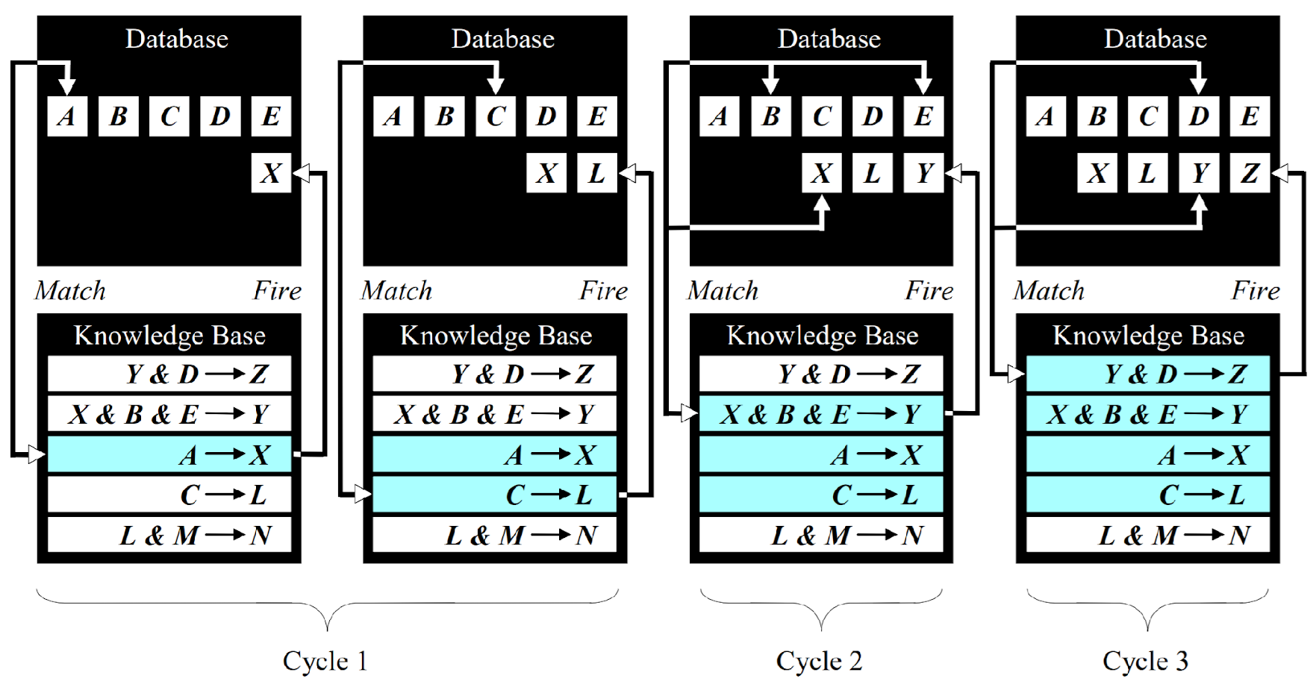
Forward Chaining
Prove Z

Slide 37
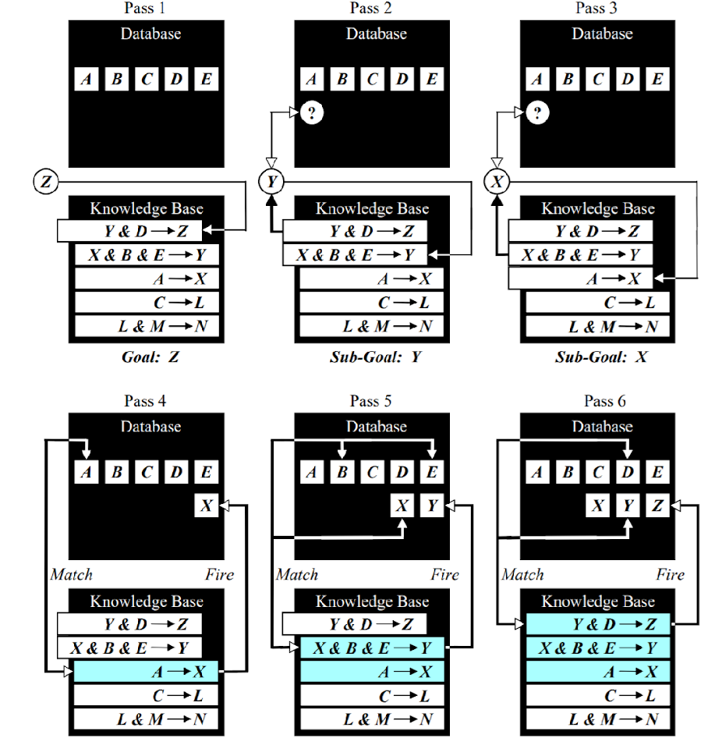
Backward Chaining
Prove Z

Slide 38
Forward Chaining in FOL
Backward Chaining in FOL

Slide 39
Example knowledge base
The law says that it is a crime for Americans to sell weapons to hostile nations. The country Nono, an enemy of America, has some missiles, and all of its missiles were sold to it by Colonel West, who is American.
Prove that Colonel. West is a criminal

Slide 40
Example knowledge base contd.
... it is a crime for Americans to sell weapons to hostile nations:
  American(x) ∧ Weapon(y) ∧ Sells(x,y,z) ∧ Hostile(z) ⇒ Criminal(x)
Nono … has some missiles, i.e., ∃x Owns(Nono,x) ∧ Missile(x):
  Owns(Nono,M₁) ∧ Missile(M₁)
… all of its missiles were sold to it by Colonel West
  Missile(x) ∧ Owns(Nono,x) ⇒ Sells(West,x,Nono)
Missiles are weapons:
  Missile(x) ⇒ Weapon(x)
An enemy of America counts as "hostile“:
  Enemy(x,America) ⇒ Hostile(x)
West, who is American …
  American(West)
The country Nono, an enemy of America …
  Enemy(Nono,America)

Slide 41
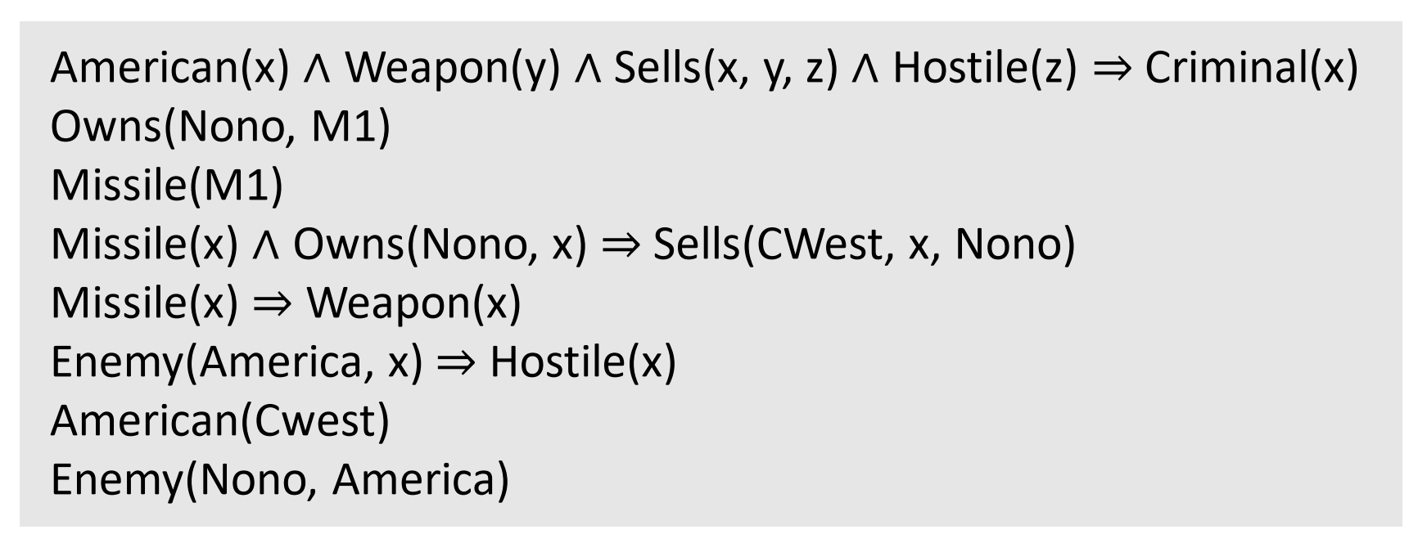
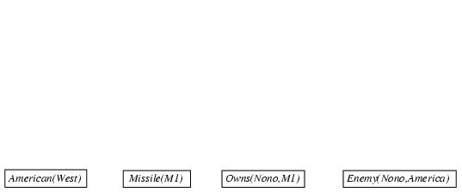
Forward chaining proof

Slide 42
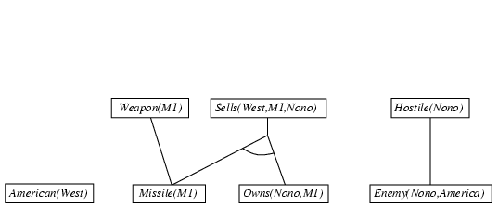
Forward chaining proof

Slide 43
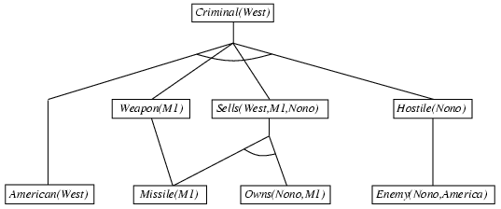
Forward chaining proof

Slide 44
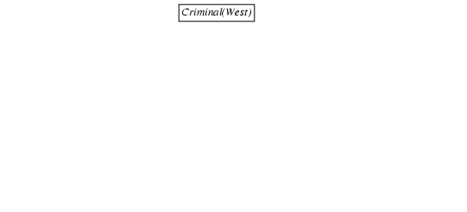
Backward chaining proof

Slide 45
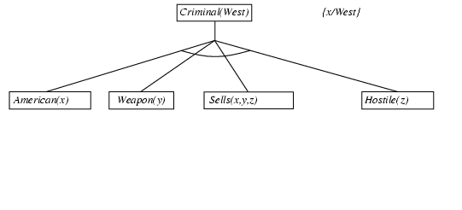
Backward chaining proof

Slide 46
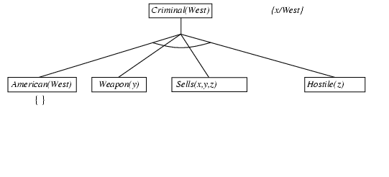
Backward chaining proof

Slide 47
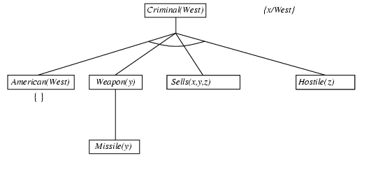
Backward chaining proof

Slide 48
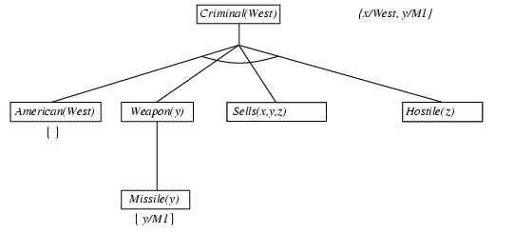
Backward chaining proof

Slide 49
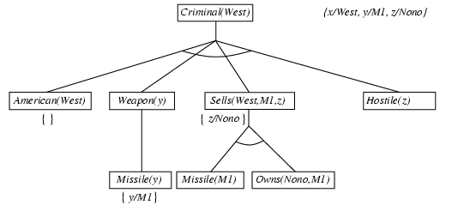
Backward chaining proof

Slide 50
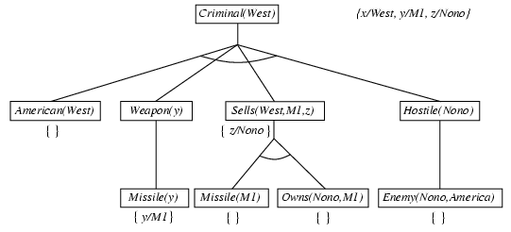
Backward chaining proof

Slide 51
Backward chaining proof

Slide 52
Forward Chaining vs Backward Chaining
The exploration of knowledge has different mechanisms in forward and backward chaining.
Backward chaining is more focused and tries to avoid exploring unnecessary paths of reasoning.
It only collects the facts it needs to know to satisfy the goal. If there are 100 facts in the system but only 3 are needed for the diagnosis, it will only trace the path to those 3 facts.
For example, If a doctor wants to know if a patient has the flu, they don't test for every disease; they test only for symptoms required by the flu rules.
Forward chaining, on the other hand is like an exhaustive search. It explores the knowledge base broadly, finding all logical implications of the starting data.
For example, If a doctor wants to know about all the symptoms of the patient first before deciding about any particular disease.

Slide 53
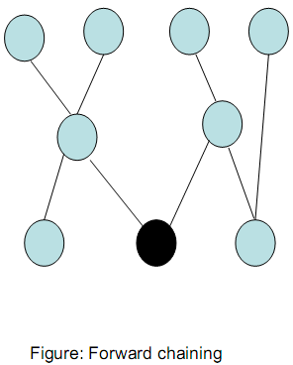
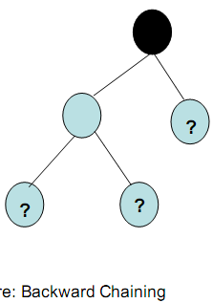
Farward Chaining vs. Backward Chaining
In the figures, each node represents a statement.
Forward chaining starts with several facts in the working memory.
  It uses rules to generate more facts.
  In the end, several facts have been added, amongst which one or more may be relevant.
Backward chaining however, starts with the goal state and tries to reach down to all primitive nodes (marked by ‘?’), where information is sought either from the working memory or subgoals within the inference process.

Slide 54
Doctor Example
Working Memory (Facts)
  D
  F
  A
Knowledge Base (Rules)
  Rule 1
  IF A
  AND B
  THEN C
  Rule 2
  IF D
  THEN E
  Rule 3
  IF F
  AND E
  THEN B
  Prove C using forward and backward chaining.

Slide 55
Fuzzy Logic

Slide 56
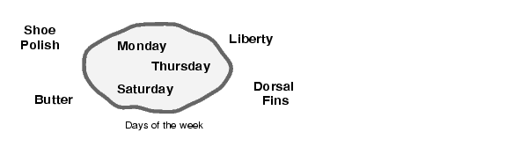
Classical/Crisp Sets
A classical set is a container that wholly includes or wholly excludes any given element.
For example, the set of days of the week unquestionably includes Monday, Thursday, and Saturday.
It just as unquestionably excludes butter, liberty etc, and so on.

Slide 57
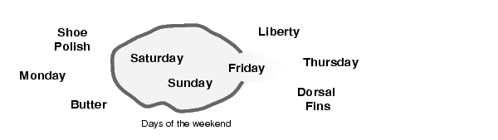
Fuzzy Sets
The diagram below is one attempt at classifying the weekend days.
Most would agree that Saturday and Sunday belong, but what about Friday?
It "feels" like a part of the weekend, but somehow it seems like it should be technically excluded. So in the diagram above Friday tries its best to sit on the fence.

Slide 58
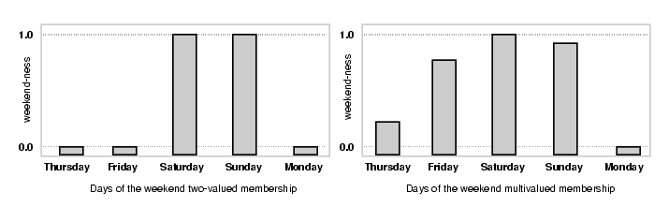
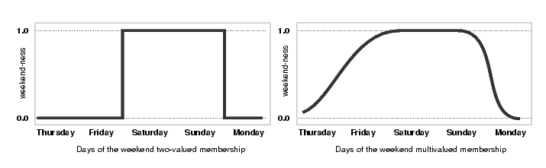
Weekend (Boolean vs Fuzzy)
On the left is a plot that shows the truth values for "weekend-ness" if we are forced to respond with an absolute yes or no response.
On the right is a plot that shows the truth value for weekend-ness if we are allowed to respond with fuzzy in-between values.

Slide 59
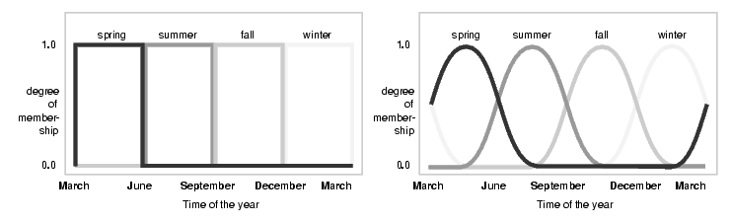
Seasons (Boolean vs Fuzzy)

Slide 60
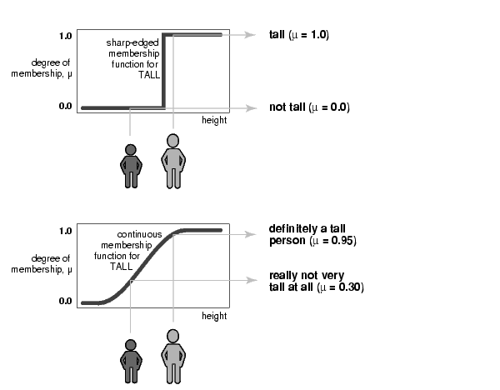
Membership Function
A membership function (MF) is a curve that defines how each point in the input space is mapped to a membership value (or degree of membership µ) between 0 and 1.

Slide 61
Membership Function Representation
Membership fuction of tall people may be represented using a fuzzy set as follows:
  Tall = membership value (µ)/height
  Tall = (0/5, 0.25/5.5, 0.7/6, 1/6.5, 1/7)
    Numerator: membership value
    Denominator: actual value of the variable
Membership value
[0-1]
Height
[5-7feet]

Slide 62
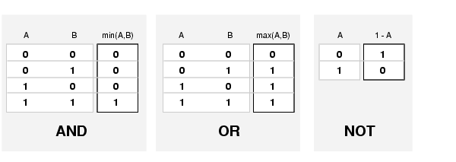
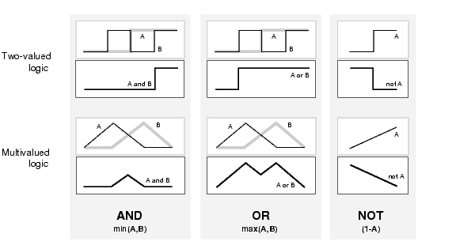
Logical Operators for Fuzzy Sets

Slide 63
Logical Operators
(Tall AND Short, Tall OR Short)
Membership value
[0-1]
Height
[0-7feet]
Tall
Short
Tall AND Short
Tall OR Short

Slide 64
Reference
Chapter 2: Artificial Intelligence: A guide to Intelligent Systems , Second Edition by MICHAEL NEGNEVITSKY

